Slide 1



ORAIMO SALES FORECASTING
By: Everything Data

Slide 2

Team Members
Calvince Kaunda
Samuel Marimbi Peter Nyakundi
Sanayet Sankaine
Gloryann Otieno

Slide 3


Business Understanding
Brand Growth
Oraimo, Africa9s leading smart- accessories brand since 2013.
Product Range
Includes earbuds, power banks, and personal care devices.
Competitive Edge
Affordable pricing, loyalty rewards, after-sales support, and influencer marketing.

Slide 4


Business Problem
Inconsistent Sales
Sales fluctuate by product and region, resulting in inefficiencies and revenue loss.
Forecasting Need
Accurate forecasting is essential to optimize inventory management and budget allocation.

Slide 5
Objectives
Forecasting Model Build a model to predict sales
for October 2024.
Performance Evaluation
Identify top cities and
products.
Actionable Insights Support financial planning
and resource allocation.
Dashboard Creation Develop a forecasting
visualization tool.

Slide 6
Metrics of Success
To achieve stationarity via Dicky Fuller test with a p-value of less than 0.05. To achieve a forecasting model with RMSE and MAE < One Million Shillings a day.

Slide 7

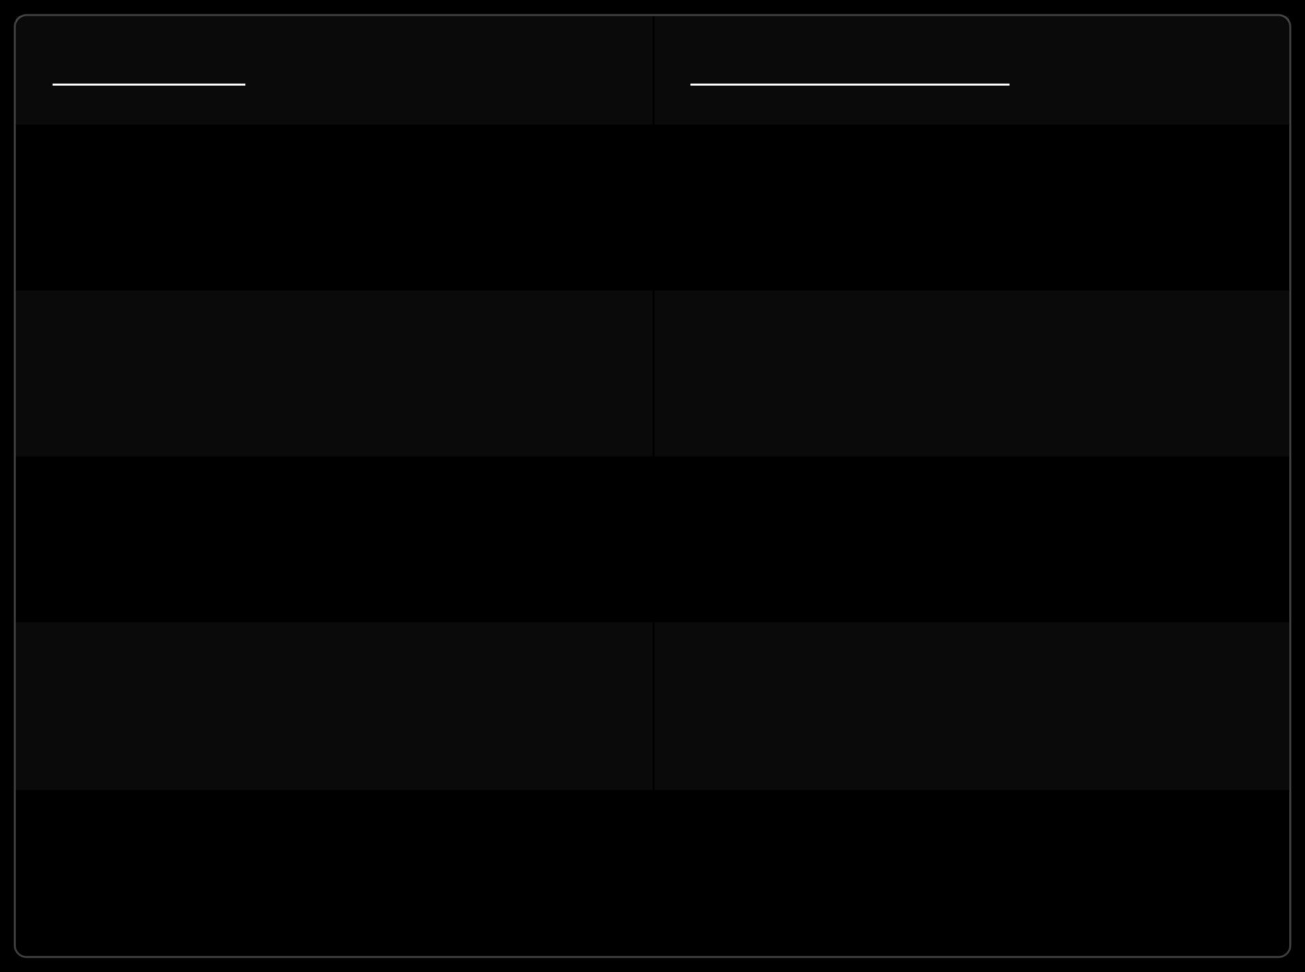
Stakeholders
AUDIENCE | GAIN/BENEFITS
Oraimo Management Team | Strategic planning and informed decisions.
Sales Team | Align sales targets with revenue forecast.
Finance Team | Accurate budgeting and cash flow Management.
Retailers & Shop Managers | Optimized stock for demand surges
Data and Business Analysts | Model Development and monitoring

Slide 8

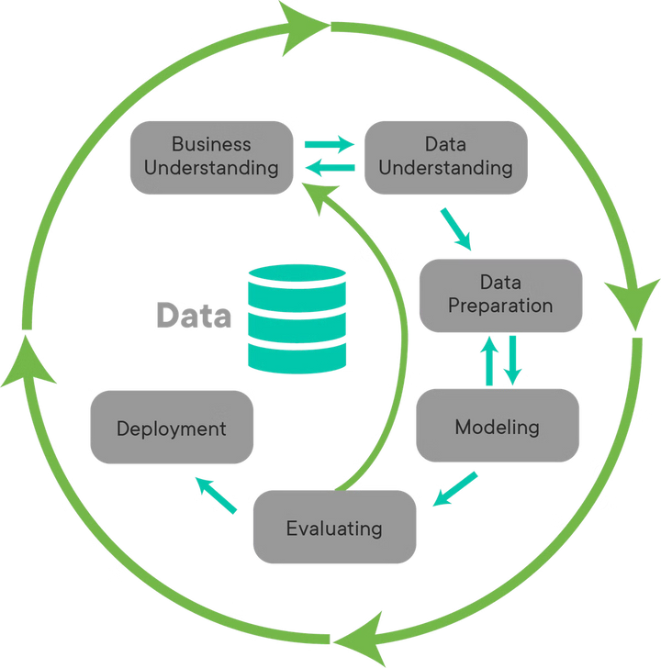
Approach
We applied a streamlined methodology using time series forecasting techniques tailored for Oraimo's sales data.

Slide 9


Data Understanding and Preparation
Data Source
Models are based on the Oraimo sales dataset from DataVerse
Dataset Overview
19,802 sales records from January to October 2024.
Data Cleaning
Handled missing, duplicates, standardized columns, and indexed by date.
Data preparation
Grouped products into five categories for analysis.

Slide 10


Exploratory Data Analysis
1
Identify Patterns
Analyze sales trends and seasonality.
2
Detect Outliers
Recognize anomalies affecting sales figures.
3
Model selection
Guide our decisions on variables for modeling.

Slide 11
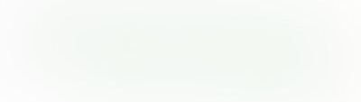
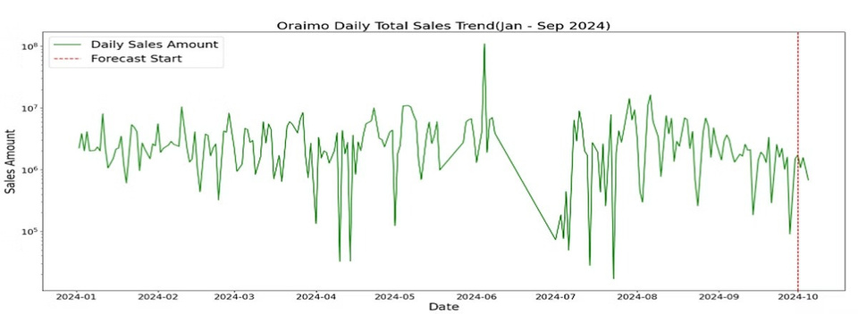
TOTAL DAILY SALES TREND
Significant daily fluctuation in sales amounts throughout the period indicate there are no seasonal/ cyclic patterns. This indicates the need for a time series model that captures irregular patterns rather than relying on cyclic trends

Slide 12
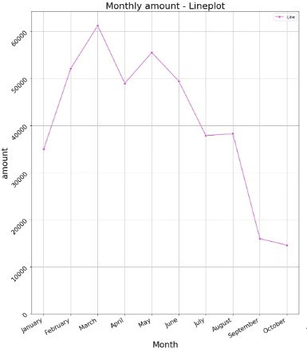
AVERAGE MONTHLY SALES
Sales typically peak in March and May, likely due to seasonal demand or special events. After May sales steadily decrease, hitting a low in October.
These fluctuations in customer purchasing behaviors may be
driven by external factors such as promotions, seasonality or
product availability

Slide 13

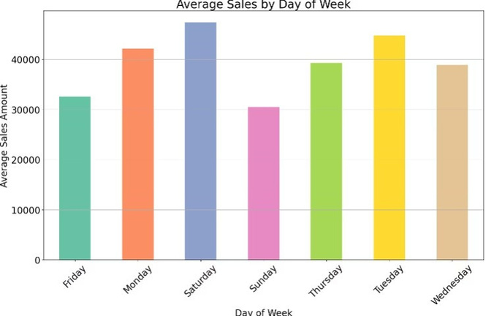
AVERAGE SALES BY DAY OF THE WEEK
Sunday had the lowest sales, while Saturday has the most
Midweek surges point to early week purchasing enthusiasm
that may be used for focused marketing campaigns

Slide 14

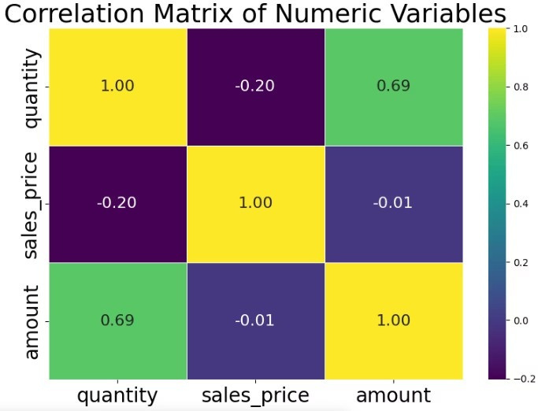
CORRELATION MATRIX OF NUMERIC VAIABLES
Quantity and Amount: A strong positive correlation of 0.69 indicates an increase in quantity of goods sold results in an increase in sales amount/revenue
Sales Price and Amount: A week negative correlation
of -0.01 suggests that there is virtually no relationship
between sales price and the total amount

Slide 15

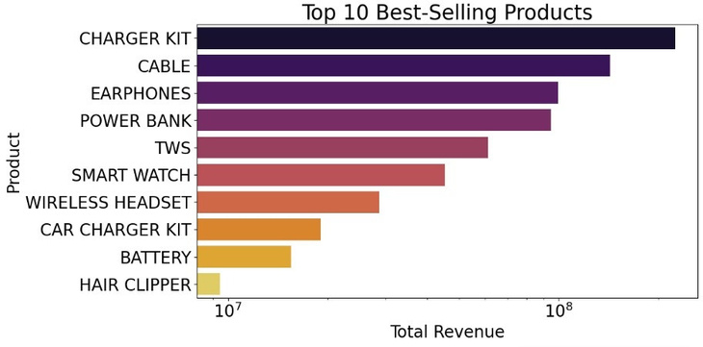
BEST SELLING PRODUCTS
Charger Kits and cables are the clear revenue leaders, with a noticeable drop off in sales for subsequent products. Hair clippers are the lowest revenue generator among the top 10 indicating there is a strong demand for charging accessories as compared to other products

Slide 16

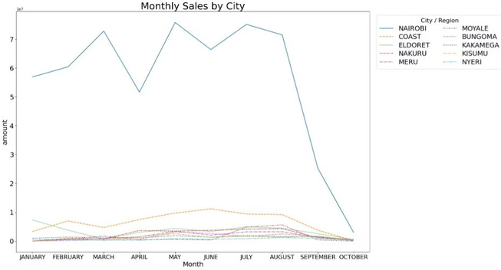
SALES PER CITY
Nairobi dominates with monthly sales peaking around Ksh350K in February and Ksh255 K in July4far above every other city.
The graph highlights strong regional differences in sales
performance, with Nairobi significantly outperforming all
other cities. There is a clear seasonal trend suggesting
optimal windows for promotions and restocking.

Slide 17
Modelling
The following models were trained and tested on the dataset:
Baseline Models: Moving Average, Simple Naïve Forecast
Classical Time Series: SARIMA
Machine Learning: Random Forest, XGBoost
Advanced Models: Light GBM
Deep Models: LSTM

Slide 18

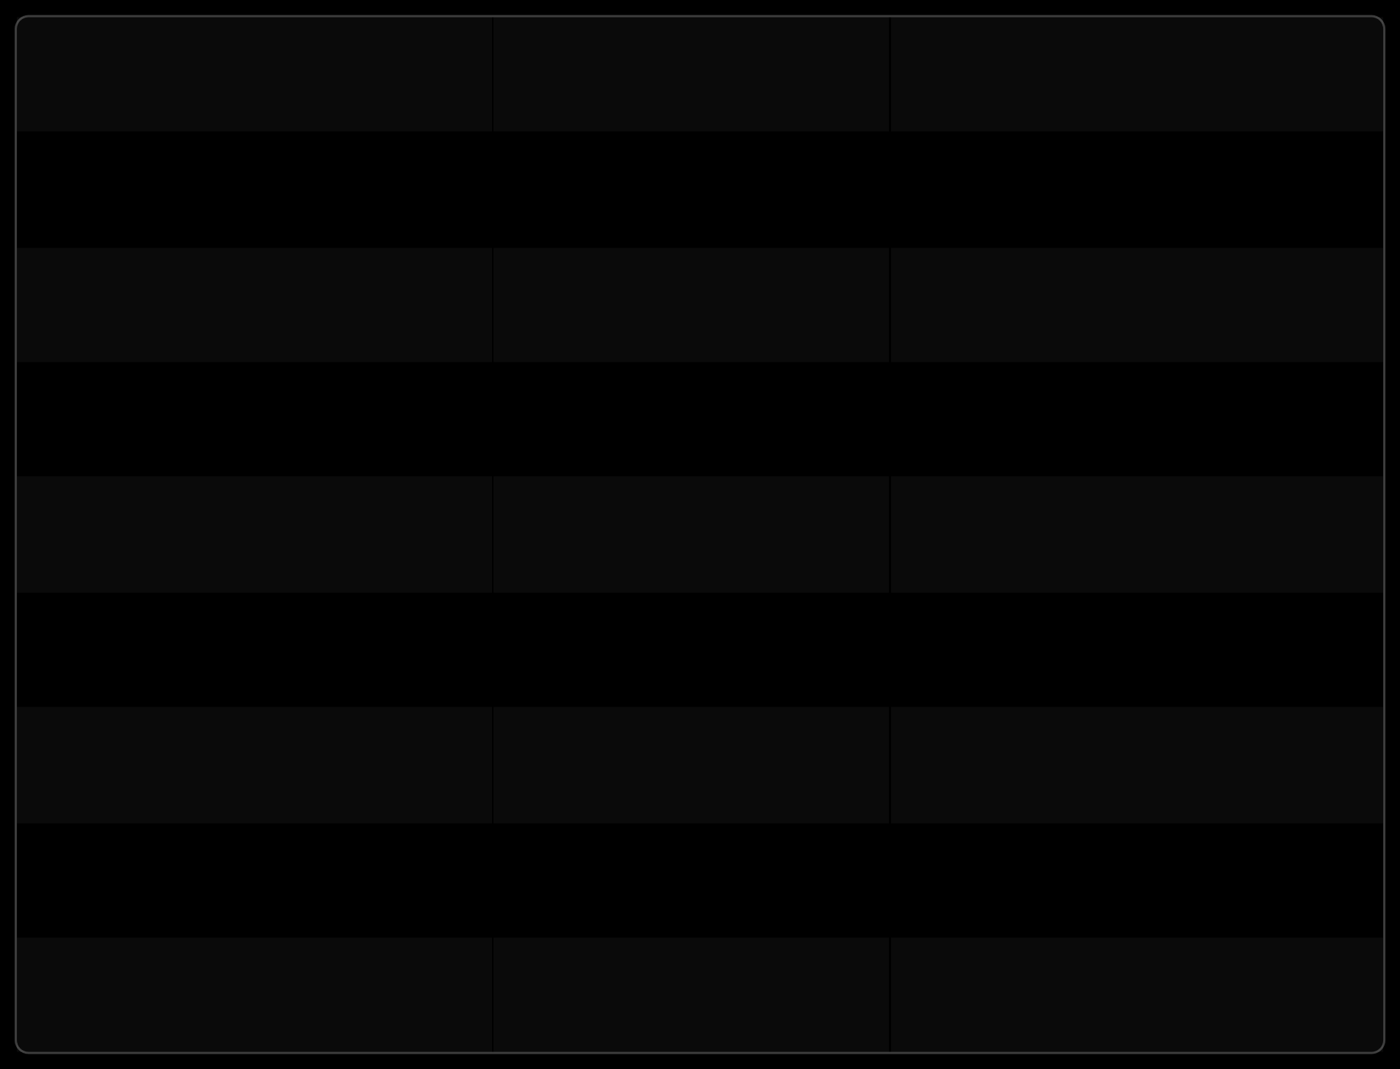
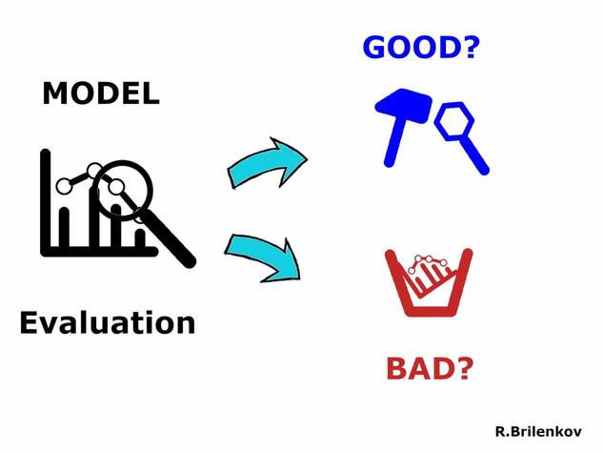
Model Evaluation
MODEL
Random Forest LightGBM XGBoost Naive Baseline Moving Average LSTM Prophet SARIMA
MAE (ksh)
556,230 702,432 768,637 1,400,624 2,116,034 2,140,613 2,166,699 2,292,082
RMSE (ksh)
821,709 887,816 1,058,7 15 1,626,283 2,330,97 1 2,172,117 2,740,919 2,996,742

Slide 19


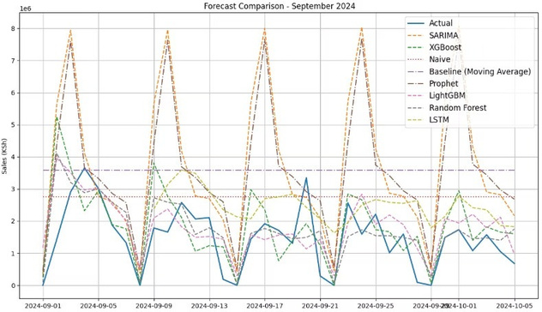
SEPTEMBER FORECAST Tree based models such as XGBoost and Random Forest should be used for forecasting as they mirror sales
trends most accurately and report the lowest MAE.
They are the most accurate

Slide 20


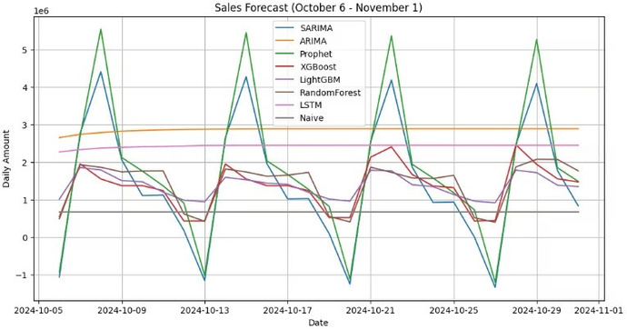
OCTOBER FORECAST Random Forest(Brown), XGBoost(Red) and LightGBM(Purple) which showed better ability to track actual
sales in September also predict considerable daily volatility in October, Prophet and SARIMA have extreme
peaks and troughs , a pattern consistent with September predictions

Slide 21

This forecasting solution helps Oraimo anticipate future demand with greater accuracy enabling for smarter business decisions
Real world use cases:
a.
Sales and revenue forecasting
b.Market Timing
c.Resource Allocation

Slide 22
CONCLUSION
We tested different methods to predict Oraimo9s daily sales. These included simple approaches like averaging past sales, traditional statistical methods, machine learning models, and even deep learning (AI).
i.
Among them, the tree-based models like XGBoost and Random Forest gave the most accurate results4much
better than the basic methods, improving accuracy by over 25%.
The LSTM model, which uses deep learning, also did really well and gave smooth, realistic sales predictions.
ii.
iii.Prophet, another advanced tool, didn9t perform as expected and often predicted too many sales, meaning it needs more fine-
tuning.

Slide 23
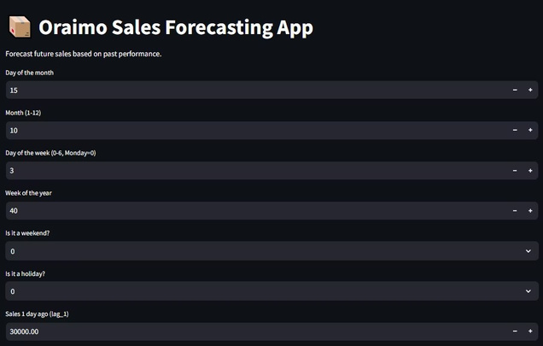
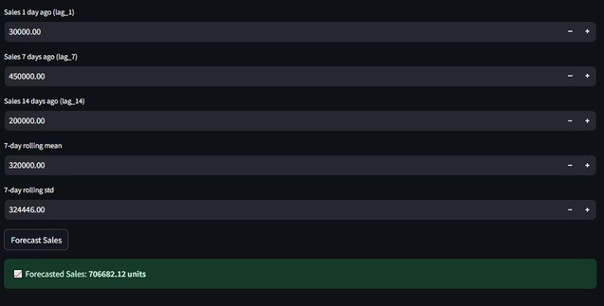
DEMO
Enter recent sales and calendar info like date or weekend, and it predicts upcoming sales
A simple web app that predicts Oraimo's future sales using past trends like recent sales, day of the week, and holidays

Slide 24

Classical time series models aren9t always sufficient. Tree based ensemble models delivered best results. LSTM produced smooth forecasts but required more data
and tuning
Data preparation is critical

Slide 25


1
2
Plan using 4- week forecasts
Use 4-wek sales forecasts to time promotions, product launches, and budget planning more effectively
Optimize stocking for weekends
Leverage forecasts to adjust reorder points, especially ahead of high-demand weekends e.g restock mid week to prepare for spikes
3
4
Align Budgets with demand
Use predicted demand to plan inventory and purchasing budgets, helping to optimize cash flow and
avoid overstocking or
understocking
Adjust Stock levels proactively
Base stock adjustments on upcoming demand forecasts to ensure timely replenishment if
fast-moving products

Slide 26

Next Steps
1
Ensemble Stacking
Create a single model of our best models, Random Forest and XGBoost in order to get the best patterns and improve accuracy
2
Holidays and campaign data
Take in a CSV or API feed of local holidays and promotional campaigns from an external source
3
Performance monitoring
Record daily forecasts vs actual mistakes in a database or CSV file. Expand data to include recent dates by incorporating present data

